Slide 1
Simulation Modeling Analysis
Selecting Input Probability Distributions
Md. Fazlul Karim Patwary
Professor
Institute of Information Technology Jahangirnagar University

Slide 2
Estimation of Parameters
Make an assumption about the distribution (Hypothesis)
After we have hypothesized a distribution, we need to perform an numerical estimates of its parameter(s)
The i.i.d. data x₁, x₂. . ., x_{n} have been used to hypothesize distributions
These data are further used to estimate the parameters
Many methods to estimate distribution parameters
Method of moments
Maximum likelihood (MLE)

Slide 3
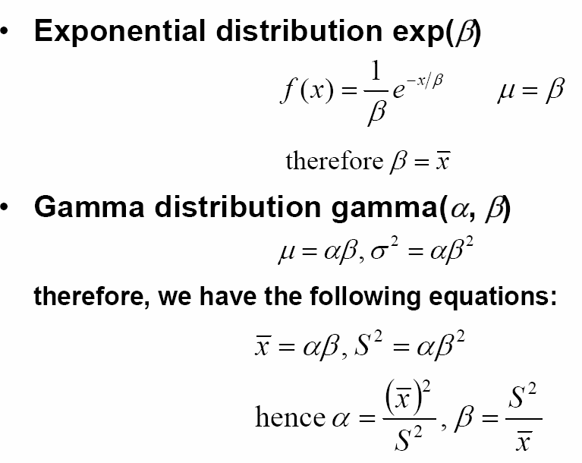
Method of Moments
The simplest method
Estimate the moments of distribution using the moments of data
First moment μ→ Estimated by sample mean
Second moment σ² → Estimated by sample variance
Express the parameters in terms of x and S²

Slide 4
Maximum Likelihood Estimator (MLE)
Suppose we have the following distribution of Final Exam results for Class A and Class D
Class A Class D
0 100
0 100
Suppose we have randomly picked three students, but all come from a same Class
These students score 99, 100, 99 respectively
Which class (Class A or Class D) do you think they are come from?

Slide 5
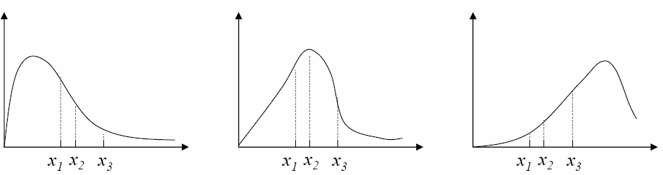
Maximum Likelihood Estimator (MLE)
Idea for MLEs:
We have observed samples x₁, x₂, ..., x_{n}
Which came from some true (unknown) parameter(s) of the distribution form
Pick the parameter(s) that make the hypothetized distribution most likely giving the samples you have at hand
An optimization (mathematical-programming) problem
The most likely distribution!

Slide 6

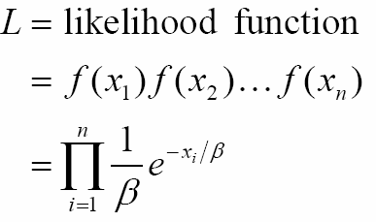

Maximum Likelihood Estimator (MLE)
In terms of probability, it is the distribution that gives the highest joint probability density
L=f(x₁, x₂ , x₃)=f(x₁)f(x₂)f(x₃) (because of independency)
E.g. for exponential distribution
Given data x₁, x₂, . . . , x_{n}, how to estimate β in the exponential distribution
Let
– Want to find the value β that maximizes L, i.e.,

Slide 7
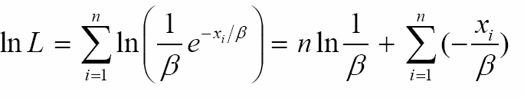
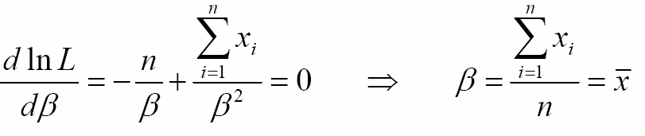
Maximum Likelihood Estimator (MLE)
However, differentiation for the product is tedious
To simplify, take log at both sides
Log is a monotonic increasing function
The parameter that maximizes L also maximizes lnL
That is we wish to find β such that

Slide 8
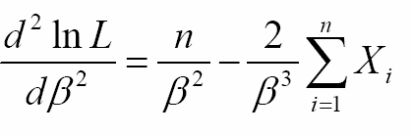
Maximum Likelihood Estimator (MLE)
Next we check the second-order sufficient conditions for a maximizer
That is, we check if the second-order derivative is < 0 when β= mean of x
Since
is < 0 when β= average of x
Therefore, β= mean of x
maximizes the likelihood function

Slide 9
Determine How Representative the Fitted Distributions are
Suppose we have hypothesized a family of probability distribution and estimated the corresponding parameters
The third step is to see if the fitted distribution agree with the actual observed data
We can have two approaches
Heuristic method
Formal statistical hypothesis tests
•χ² goodness-of-fit tests
Confidence intervals

Slide 10
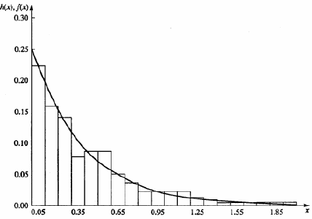
Heuristic method: Histogram over Plot
Plot f(x) of the fitted distribution over the histogram h(x)
Look for similarities
E.g. interarrival-time, observed histogram vs. fitted exponential

Slide 11

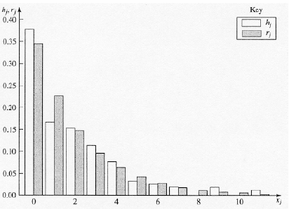
Heuristic method: Frequency Comparison
Frequency Comparison for Discrete Data
Let h_{j}= the observed proportion of data that are equal to the jth possible value x_{j}
Let be the expected proportion of the data equal to x_{j} if the fitted probability mass function is correct
Plot h_{j} and r_{j} together, look for similarities

Slide 12
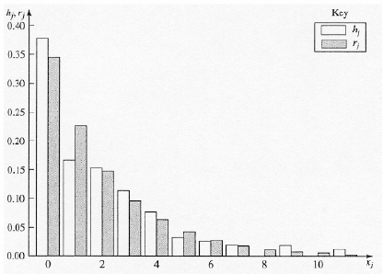
Heuristic method: Frequency Comparison
Frequency Comparison for Continuous Data
Histogram intervals interval [b_{j–1}, b_{j}] for j = 1, 2, ..., k, each of width Δb
Let h_{j} = the observed proportion of data in jth interval
Let r_{j} = the expected proportion of data in jth interval if the fitted distribution is correct
Plot h_{j} and r_{j} together, look for similarities

Slide 13
Chi-square Goodness-of-fit Test
We perform a formal statistical hypothesis test on the null hypothesis:
Our null hypothesis is: the distribution of observed data and the distribution of the fitted distribution are the same
So we have:
H₀: the x_{i}’s are i.i.d. random variables with distribution function F
(where F is the fitted distribution)
Caution:
Failure to reject H₀ should not be interpreted as “accepting H₀ as being true”
H₀ is virtually never exactly true
We are looking for an “adequately” fit of the distribution

Slide 14
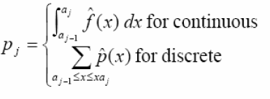
Heuristic method: Histogram over Plot
Let n be the total number of pieces of the observed data
Divide range of data into k intervals, not necessarily of equal width:
[a₀, a₁), [a₁, a₂), ..., [a_{k}–1, a_{k}]
a₀ could be –∞ and a_{k} could be +∞
Compare actual amount of observed data in each interval with what the fitted distribution would predict
Let N_{j}= the number of observed data points in the jth interval
Let p_{j}= the expected proportion of the data in the jth interval if the fitted distribution were true:

Slide 15
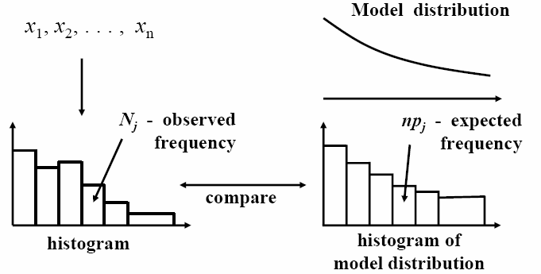
Chi-square Goodness-of-fit Test
np_{j} = expected number of points in the jth interval (i.e. those under fitted distribution)
If fitted distribution is correct, would expect that N_{j} ≈ np_{j}

Slide 16

Chi-square Goodness-of-fit Test
Define test statistics
If the data fit the distribution well (i.e., H₀ is true), then and D should be small
If D is large, then the distribution is not a good distribution and we shall reject the hypothesis H₀
But how large is large?
– Under H₀: Fitted distribution is correct, D has (approximately) a chi-square distribution with k –1 degree of freedom

Slide 17
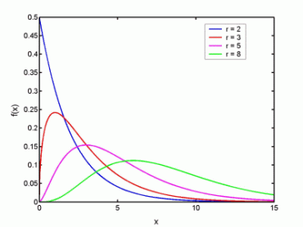
Chi-square Distribution
Chi-square distribution:
If X_{i} where i = 1 to k are independent, normally distributed random variables with mean 0 and variance 1, then the random variable
χ²=X₁²+X₂²+…+X_{r}²
is distributed according to the chi-square distribution with r is called the number of degrees of freedom
– Also written as the χ² distribution

Slide 18
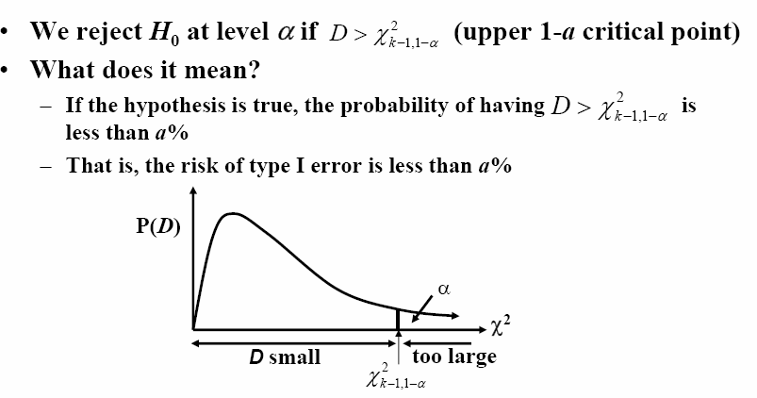
Chi-square Distribution

Slide 19
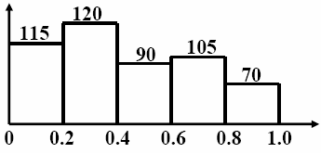
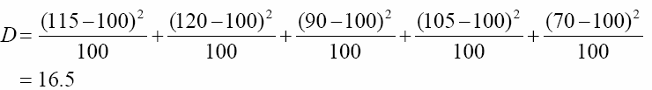

Chi-square Goodness-of-fit Test
Example
To test the uniformity of a random number generator
n=500, the histogram is
The expected frequency of each bin is n*0.2=100
Since , the hypothesis is rejected at a 5% confidence level

Slide 20
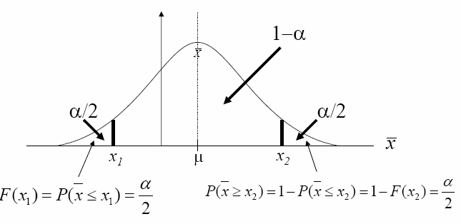
Confidence Intervals
Recall that probability of being exactly equal to a particular value is negligible
It is meaningless to compare if mean=average (point estimate)
Instead of point estimate, we can resort to an interval estimate
The statistically correct way
Estimate the population mean by an interval
Confidence interval (x₁, x₂)

Slide 21
Probability Plots
Similar to the heuristic approaches of plotting the histograms as introduced, probability plots are another graphical comparison between the distribution of our collected data and a fitted distribution.
For continuous distribution, we can determine how representative the fitted distributions are by comparing the cumulative distribution functions of the observed data and fitted model
Quantile-quantile (Q-Q) plots
Probability-probability (P-P) plots

Slide 22
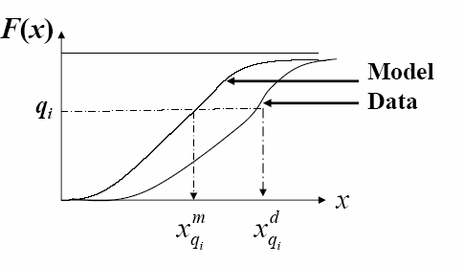
Q-Q Plot (quantile-to-quantile plot)
How we define quantile?
– Suppose F(x) is the distribution function for a continuous random variable. q-quantile of F(x) is the number x_{q} such that F(x_{q})=q where 0≤q≤1
(from theoretical distribution)
(from our data)

Slide 23
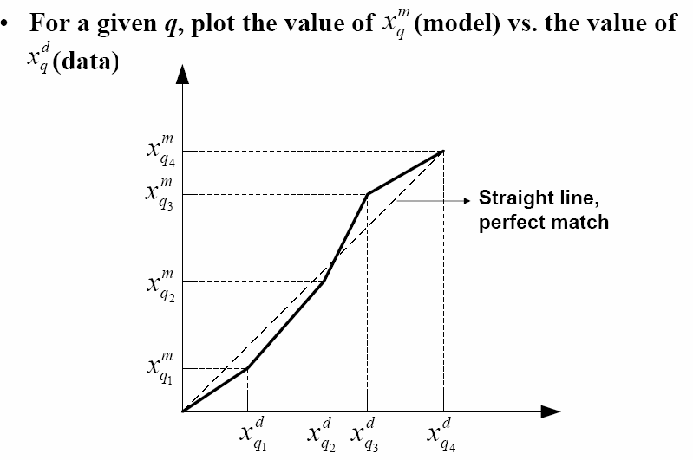
Q-Q Plot (quantile-to-quantile plot)

Slide 24
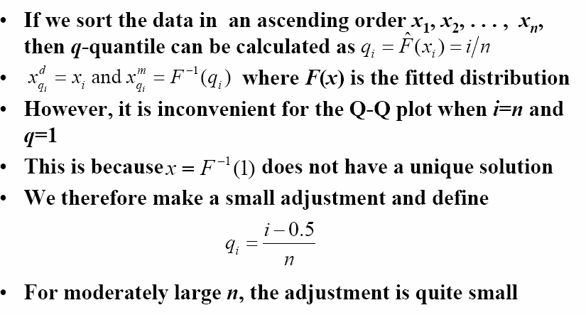
Q-Q Plot (quantile-to-quantile plot)

Slide 25
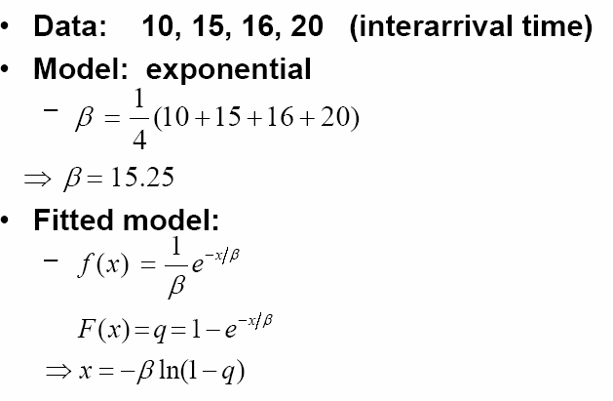
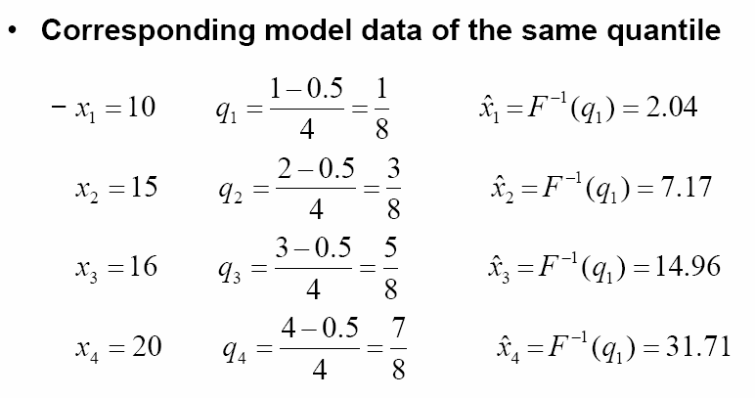
Q-Q Plot: An Example

Slide 26
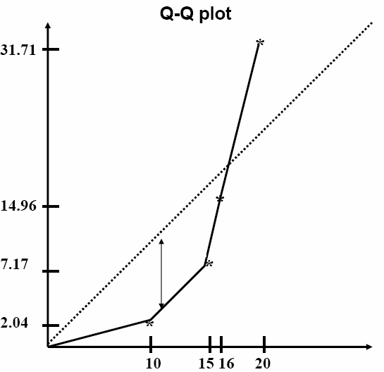
Q-Q Plot: An Example
The ideal case (observed data have the same distribution as the theoretical model) should give a straight line
Poor fit!

Slide 27


P-P Plot (probability-to-probability plot)
Problem of Q-Q plot
For some F(x) of the model distributions, there is no closed form for their inverse (e.g. for Gamma and Normal distributions)
Therefore it is difficult to find x_{i} from q_{i}
Better to use P-P plot (probability-probability plot)
P-P Plots: for a given data x_{i}
Find its corresponding in the data set
Then find in the fitted model
–

Slide 28
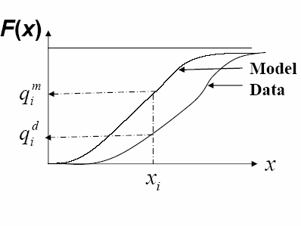
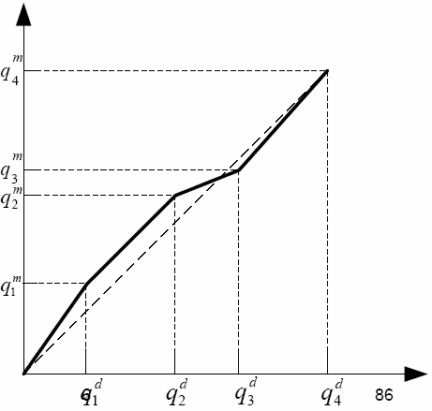
P-P Plot (probability-to-probability plot)

Slide 29
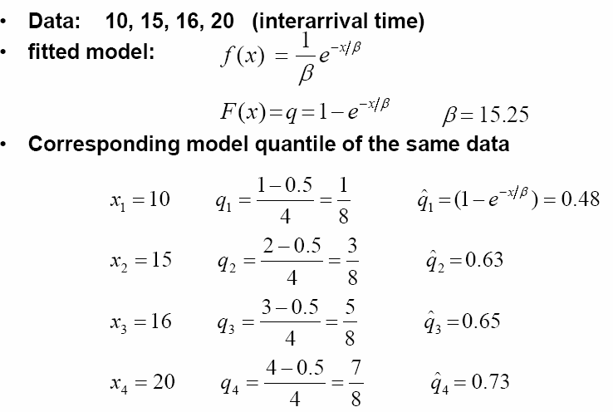
P-P Plot: An Example

Slide 30
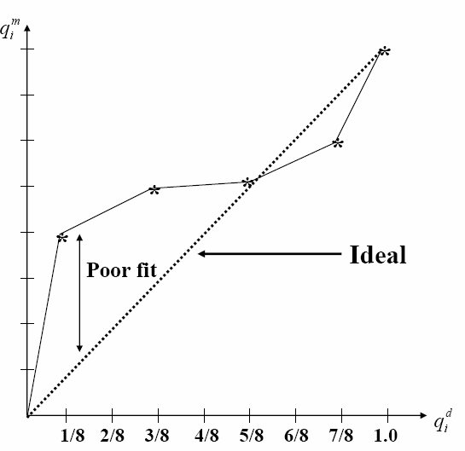
P-P Plot: An Example

